Slide 1
AMITY
UNIVERSITY
A
PATNA
Internship Presentation
React Native Developer Intern
(AI-Assisted Development)
ToonsCode Software Training Institute
Presented By
Under the Supervision of
Ayush (A45304825002) - BCA
Dr. Sushant Kumar Dubey
Amity Institute Of Information Technology, Patna
10 August, 2026

Slide 2
AMITY
UNIVERSITY
A
PATNA
Internship Introduction
Internship role: React Native Developer Intern (AI-Assisted Development).
Duration: 20th June 2026 to 2nd August 2026.
Organization: ToonsCode Software Training Institute.
Focus area: cross-platform mobile application development using React Native and AI-assisted coding practices.

Slide 3
AMITY
UNIVERSITY
A
PATNA
Organization Profile
ToonsCode is a software training institute under Chapterfeed Learning Space Private Limited.
The internship emphasized practical mobile app development, reusable UI components, REST APIs, Firebase integration, debugging, and deployment workflows.
Mentorship was provided by experienced professionals during the training period.

Slide 4
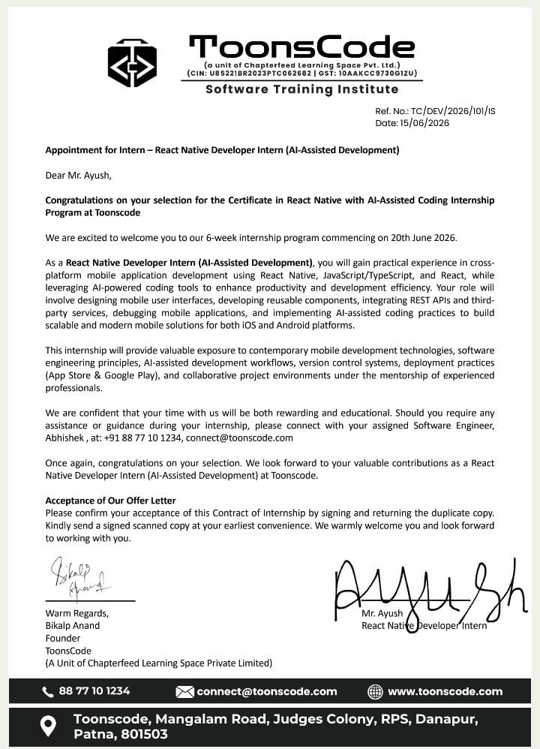
AMITY
UNIVERSITY
A
PATNA
Offer Letter

Slide 5
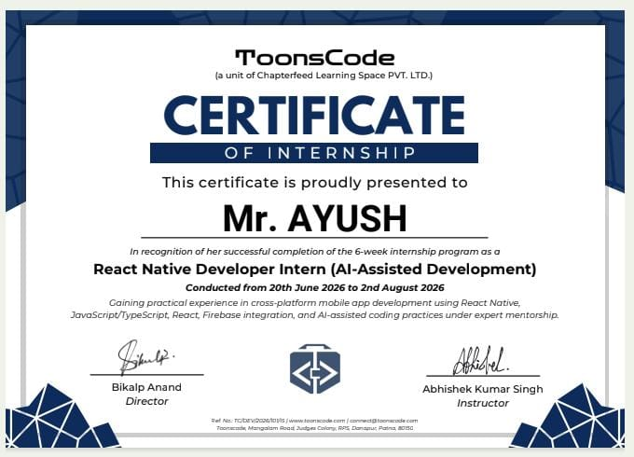
AMITY
UNIVERSITY
A
PATNA
Internship Certificate

Slide 6
AMITY
UNIVERSITY
A
PATNA
Work Completed
Designed and improved mobile application screens using React Native and TypeScript.
Implemented and tested reusable components for authentication, product browsing, cart, checkout, and order tracking.
Integrated Firebase services for authentication, database storage, and app data management.
Used AI-assisted development tools to improve productivity and debugging efficiency.

Slide 7
AMITY
UNIVERSITY
A
PATNA
Learning Outcomes
Improved understanding of Expo, React Native, JavaScript, TypeScript, and React concepts.
Learned Firebase Authentication, Firestore data modeling, Storage, and security-rule basics.
Gained exposure to REST APIs, mobile UI design, Git/version control, testing, and deployment practices.
Developed better problem-solving and project documentation skills.

Slide 8
AMITY
UNIVERSITY
A
PATNA
Project Contribution
Applied internship learning to the quickCart mobile application.
Built customer-facing workflows such as login, location selection, product listing, cart, checkout, and orders.
Created admin workflows for products, categories, cities, users, and order-status management.
Focused on practical quick-commerce use cases for groceries and daily essentials.

Slide 9

AMITY
UNIVERSITY
A
PATNA
Conclusion
The internship helped bridge academic knowledge and practical mobile app development.
Thank You
Ayush (A45304825002) - BCA

